Slide 1

Identify, Address and Monitor Barriers to Community Participation and Social Inclusion
CHCDIS012 - Support community participation and social inclusion (Release 1)

Slide 2



The previous presentations talked about opportunities and strategies to facilitate the PWD’s community participation and social inclusion.
To ensure that the PWD can participate in the community, you identify and monitor barriers that may get in the PWD’s way.
Barriers refer to the factors that stop the PWD from community participation and social inclusion.
Identify, Address and Monitor Barriers to Community Participation and Social Inclusion

Slide 3

Barriers come in forms such as:
Lack of access to PWD-inclusive stairways, building entrances, parking areas, etc.
Limited access to training, employment and education.
Identify, Address and Monitor Barriers to Community Participation and Social Inclusion

Slide 4
In this presentation, you will learn how to:
Identify barriers to community participation and social inclusion
Identify and report gaps in assistive technology needs
Identify solutions to overcome barriers
Implement strategies to address barriers to community participation
Identify, Address and Monitor Barriers to Community Participation and Social Inclusion

Slide 5
In this presentation, you will learn how to:
Identify need for advocacy in relation to the PWD’s participation
Monitor the effectiveness of strategies
Identify own limitations in addressing issues and seek advice from supervisor
Identify, Address and Monitor Barriers to Community Participation and Social Inclusion

Slide 6

3.1
Identify Barriers to Community Participation and Social Inclusion

Slide 7
The social model of disability defines disability as the relationship between a person with an impairment and the barriers set by society.
One of your responsibilities as a support worker is to identify the barriers to community participation and social inclusion.
To do this, you must understand various concepts of barriers PWDs may face.
Identify, Address and Monitor Barriers to Community Participation and Social Inclusion

Slide 8
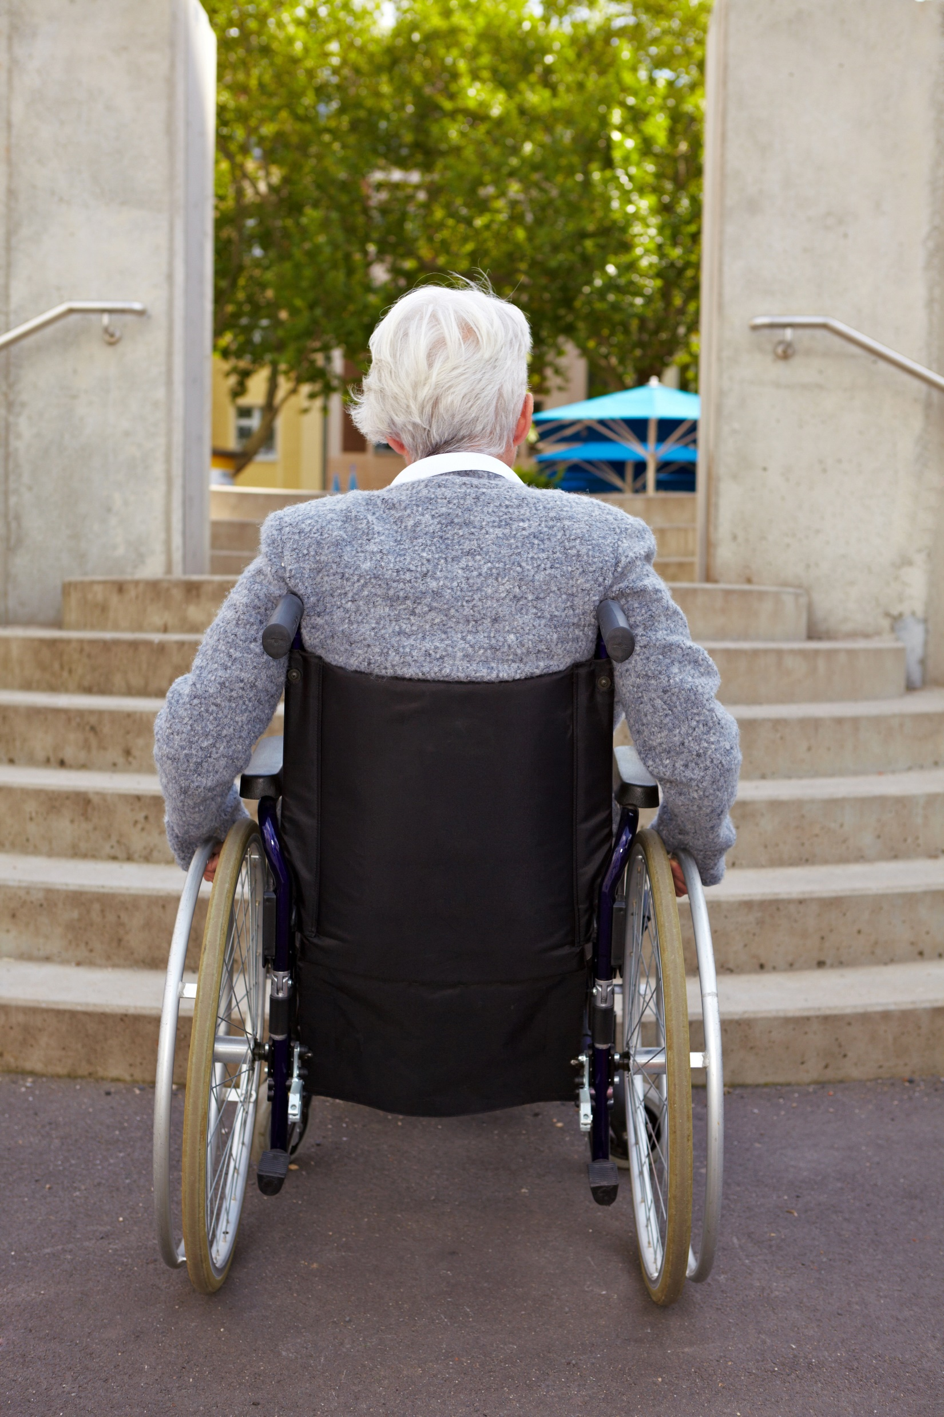
3.1.1 Common Barriers PWDs May Face
Barriers that PWDs may face following are :
Physical Barriers – These are structural obstacles that can affect one's ability to move freely.
Systemic Barriers – These barriers are related to laws or policies that discriminate against people with impairments.
Identify, Address and Monitor Barriers to Community Participation and Social Inclusion

Slide 9
Aside from what has been mentioned, PWDs may also encounter the following barriers to community participation and social inclusion:
Personal
Skill
Structural
Resource
Psychological
Stigma and Self-Stigma
Discrimination
Identify, Address and Monitor Barriers to Community Participation and Social Inclusion

Slide 10
Personal Barriers
A person’s cultural background may affect their ability to take part in activities.
Some cultures may not be very accepting of disabilities.
This lack of acceptance will prevent PWD from getting their needed services.
Aside from their cultural background, a person may also experience barriers because of their family that is usually their first and biggest supporter.
Yet some families may still hold on to negative views about disabilities.
Identify, Address and Monitor Barriers to Community Participation and Social Inclusion

Slide 11
A PWD may have family members who tend to have the following characteristics:
Do not believe in using disability services
Do not have enough resources to afford disability services
Do not believe in the disability or minimise its effect
Do not have enough awareness about their disability
Identify, Address and Monitor Barriers to Community Participation and Social Inclusion

Slide 12
Skill Barriers
PWD may be unsure about joining activities for several reasons.
They may not have enough training opportunities to develop their skills because of stigma against PWDs.
Having limited skills can restrict their opportunities to participate in other community activities.
Identify, Address and Monitor Barriers to Community Participation and Social Inclusion

Slide 13
Structural Barriers
PWDs are one of the minorities most vulnerable to structural barriers.
Structural barriers take place when:
A service location is not accessible by public transport
Opening hours do not match the person’s availability
The person does not have a complete understanding of the services that are available
Identify, Address and Monitor Barriers to Community Participation and Social Inclusion

Slide 14
Resource Barriers
Sometimes, there are simply no available resources that can meet your client’s needs.
Examples of lack of resources include the following:
Lack of communication resources
Lack of transportation resources
Identify, Address and Monitor Barriers to Community Participation and Social Inclusion

Slide 15
Psychological Barriers
Psychological barrier pertains to a mental state that may prevent a person from making the best decisions. Psychological obstacles also impact one's capacity for rational communication and interaction.
Psychological barriers include :
Personal perception
Lack of self-confidence
Low self-esteem
Negative body image
Perception of others
Identify, Address and Monitor Barriers to Community Participation and Social Inclusion

Slide 16
Stigma and Self-stigma
Stigma is labeling people with disabilities in a harmful and discriminatory manner. Stigma arises when a person focuses on the person rather than focusing on their illness.
Some causes of stigma include the following:
Superstition
Lack of knowledge and misinformation
Tendency to fear and exclude people who are perceived as different
Identify, Address and Monitor Barriers to Community Participation and Social Inclusion

Slide 17
Stigma and Self-stigma
When a person internalises stigma and other negative attitudes toward them, they start believing in the negative stereotypes that have been prescribed to them.
The self-esteem of PWDs may be reduced due to internalising stigma. This results to self-stigma.
Self-stigma is measured using four categories, including the following:
Alienation
Stereotype endorsement
Discrimination experience
Social withdrawal
Identify, Address and Monitor Barriers to Community Participation and Social Inclusion

Slide 18
Stigma and Self-stigma
Some of the harmful effects of stigma and self-stigma include:
Feelings of shame, hopelessness, and isolation
Reluctance to ask for help or to get treatment
Lack of understanding by family, friends, or others
Fewer opportunities for employment or social interaction
Bullying, physical violence or harassment
Self-doubt
Identify, Address and Monitor Barriers to Community Participation and Social Inclusion

Slide 19
Discrimination
Disability discrimination happens when a person with a disability is poorly treated or does not get the same opportunities as others in the same situation.
It can also occur when an unreasonable policy or rule applies to everyone but unfairly affects people with a particular disability.
Disability discrimination can be:
Direct discrimination
Indirect discrimination
Identify, Address and Monitor Barriers to Community Participation and Social Inclusion

Slide 20
3.1.2 Recognising Barriers Clients are Facing
Here are some strategies you can follow to recognise barriers your clients may face:
Review the individualised plan of the client.
See if the client can physically access a service or amenity.
See if the environment of the client is accessible.
Interview the client.
Interview the family, friends and carers of the client.
Identify, Address and Monitor Barriers to Community Participation and Social Inclusion

Slide 21
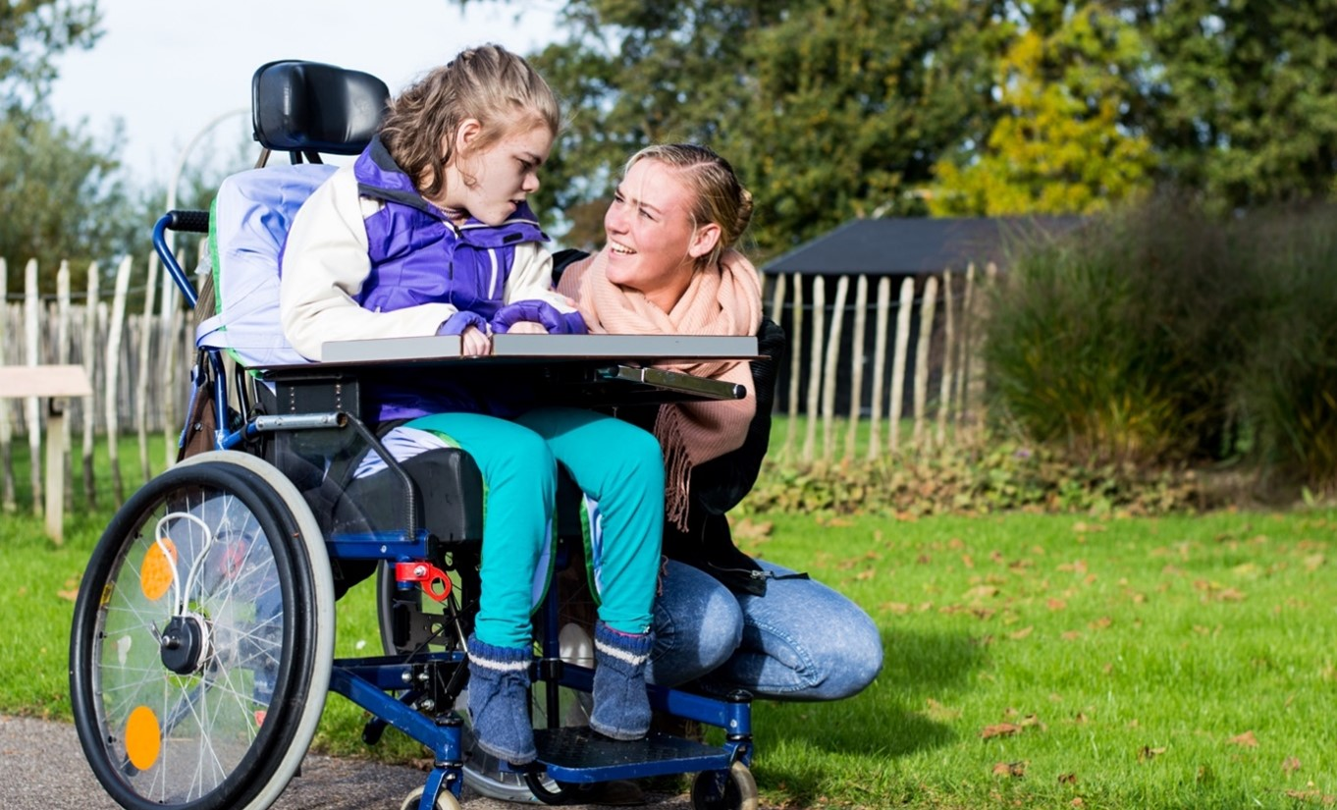
3.2
Identify and Report Gaps in Assistive Technology Needs

Slide 22
Using assistive technology enables a PWD to:
Improve their independence by easing the decision-making process
Take care of themselves and others despite their impairments
Participate in their community fully by allowing them to work and volunteer independently
Identify, Address and Monitor Barriers to Community Participation and Social Inclusion

Slide 23
Assistive technology is vital in promoting and maintaining the independence of PWDs in society.
The technology either enables or eases the process for a PWD to perform a task.
It minimises the impact of their impairment and increases their safety.
Part of recognising the barriers to community participation your clients face is identifying gaps in their use of assistive technology.
This identification must be made in consultation with PWDs.
Identify, Address and Monitor Barriers to Community Participation and Social Inclusion

Slide 24
Here are some examples of gaps in a client’s use of assistive technology:
Lack of appropriate training for support staff to assist the client’s use of assistive technology
Lack of access to assistive technology
Lack of adaptation to the client’s changing needs
Identify, Address and Monitor Barriers to Community Participation and Social Inclusion

Slide 25

When consulting with your clients to identify gaps in assistive technology, you may consider the following strategies:
Ask for feedback from the client.
Observe the client.
Ask the client’s family, carers and other relevant personnel for their observations.
Identify, Address and Monitor Barriers to Community Participation and Social Inclusion

Slide 26
Once you have acquired enough information on the gaps of assistive technology, you must report these gaps accordingly.
There may be some gaps that you may not be able to address as they are outside of your capabilities.
For example, if you have no prior knowledge of the assistive device, you should report the concern to a technician.
Or, if a client requests assistance in acquiring funding for assistive technology, you may report this to a social worker to aid them in applying for programs such as the NDIS.
Identify, Address and Monitor Barriers to Community Participation and Social Inclusion

Slide 27
3.2.1 Report Gaps in Assistive Technology According to Organisational Policies and Procedures
Once you have identified gaps in the client’s use of assistive technology, you should report these gaps.
Reporting can be done in two ways:
Verbal report to supervisor
Written report for documentation
Identify, Address and Monitor Barriers to Community Participation and Social Inclusion

Slide 28

As a support worker, you must be familiar with your organisation's policies and procedures for reporting.
These include the following guidelines:
Style guide
Records storage
Privacy and confidentiality
Organisational chart
Identify, Address and Monitor Barriers to Community Participation and Social Inclusion

Slide 29

3.3
Identify Solutions to Overcome Barriers

Slide 30
A person-centred approach requires collaboration between you, the PWD and your organisation.
You all work towards the same goal:
For the PWD to participate in the community freely
For the PWD to feel socially included
Identify, Address and Monitor Barriers to Community Participation and Social Inclusion

Slide 31
As a support worker, you must collaborate with your clients to identify solutions to overcome their identified barriers.
Collaborating with clients brings many advantages, such as:
Promoting the client’s freedom to solve their problems
Ensuring that no barrier will remain unaddressed
Becoming a way to form a better working relationship with the client
Identify, Address and Monitor Barriers to Community Participation and Social Inclusion

Slide 32

3.3.1 Collaborating With the PWD to Find Solutions
Collaboration means working with another PWD or group to achieve a goal.
Effective collaboration simply means achieving the goals set by the collaborating teams.
Your goal in collaborating with your clients is to come up with solutions to overcome their identified barriers.
Identify, Address and Monitor Barriers to Community Participation and Social Inclusion

Slide 33
Here are some strategies to identify solutions in collaboration with your clients:
Review the client’s individualised plan.
Assess the reasonable adjustments.
Make an action plan.
Identify, Address and Monitor Barriers to Community Participation and Social Inclusion

Slide 34

3.4
Implement Strategies to Address Barriers to Community Participation

Slide 35
As a support worker, you must treat people with disabilities with compassion, dignity and respect.
This means that you must support the PWD in a way that:
Respects the PWD to increase their self-worth
Motivates the PWD to achieve their goals
Empowers the PWD to improve their lives
Identify, Address and Monitor Barriers to Community Participation and Social Inclusion

Slide 36
You must know how to respect, motivate and empower as they implement strategies to address barriers to community participation.
Not doing so will severely limit the quality of support you can provide to them. It will also make your job more difficult.
This is because you will be caring for someone who lacks the initiative to help themself.
Identify, Address and Monitor Barriers to Community Participation and Social Inclusion

Slide 37
3.4.1 Respecting the PWD to Increase Their Self-Worth
Respect refers to believing that the PWD is valued.
This involves providing support that recognises the individuality and preferences of the PWD.
Respectfully interacting with the PWD can increase their self-worth and leads to the PWD being positively seen by those around them.
Identify, Address and Monitor Barriers to Community Participation and Social Inclusion

Slide 38
To respectfully implement strategies to overcome barriers to community participation, you must be able to do the following:
Treat the client as you would anyone else.
Use people-first language.
Do not make assumptions for the client.
Avoid patronising the client.
Support the client’s choices and decisions.
Identify, Address and Monitor Barriers to Community Participation and Social Inclusion

Slide 39

3.4.2 Motivating the PWD to Achieve Their Goals
Motivation is an essential aspect of the well-being of PWDs.
Motivation allows a person to engage in activities and become receptive to strategies.
These strategies are designed to assist them in overcoming barriers to fully participate in their communities.
Identify, Address and Monitor Barriers to Community Participation and Social Inclusion

Slide 40
There are two kinds of motivation:
Internal Motivation
External Motivation
Satisfaction of applying oneself is enough to encourage a person to accomplish their goals
Determined by the values and goals of the person
External rewards such as praise and approval are used as motivators
Determined by the values and goals of others.
Identify, Address and Monitor Barriers to Community Participation and Social Inclusion

Slide 41

To implement strategies that motivate clients to overcome barriers to community participation, you must be able to do the following:
Determine what motivates the client.
Foster a growth mindset.
Develop meaningful relationships with the client.
Identify, Address and Monitor Barriers to Community Participation and Social Inclusion

Slide 42
3.4.3 Empowering the PWD to Improve Their Lives
Empowering means giving the PWD the power to control their lives.
It involves investing valuable time, effort and resources to become stronger and more confident.
When empowered, the PWD will require significantly less assistance.
This is because they will be more willing to take the initiative to improve their lives.
As a support worker, you must ensure that the clients can exercise their independence when interacting with their communities and social networks.
Identify, Address and Monitor Barriers to Community Participation and Social Inclusion

Slide 43
The Principles of a Human Rights-Based Approach
A human rights-based approach turns human rights into actual policies and practices.
It transcends the ‘what’ of human rights and focuses more on the ‘how’.
The approach mainly uses human rights as a basis for overcoming barriers to community participation and social inclusion.
Identify, Address and Monitor Barriers to Community Participation and Social Inclusion

Slide 44
The approach has five common principles, namely:
Participation – It is a human rights-based approach that means that everyone has to take part in decisions that affect their human rights.
Accountability – It is a human rights-based approach requires effective monitoring of compliance with:
Human rights standards
Achievement of human rights goals
Effective remedies for breaches of human rights
Identify, Address and Monitor Barriers to Community Participation and Social Inclusion

Slide 45

The approach has five common principles, namely:
Non-discrimination and equality – It is a human rights-based approach that must prevent discrimination.
Empowerment – It is a human rights-based approach that means everyone is entitled to exercise their rights.
Identify, Address and Monitor Barriers to Community Participation and Social Inclusion

Slide 46
The approach has five common principles, namely:
Legality – It is a human rights-based approach requires the law to:
Recognise and enforce human rights and freedoms
Be consistent with human rights principles
Identify, Address and Monitor Barriers to Community Participation and Social Inclusion

Slide 47
Social and Emotional Wellbeing Frameworks
According to the World Health Organization (WHO), social and emotional wellbeing are closely related to the concept of mental health. A person with stable mental health has the capacity to do the following:
Can realise own abilities
Can cope with the everyday stresses of life
Can work productively
Can contribute to the community
Identify, Address and Monitor Barriers to Community Participation and Social Inclusion

Slide 48
A person with disability achieves good mental, social and emotional well-being when their needs relevant to building relationships and emotional fulfilment are met and when distress arising from unmet needs in other domains are minimised. The other domains include the following:
Physical domain
Informational domain
Practical domain
Spiritual domain
Identify, Address and Monitor Barriers to Community Participation and Social Inclusion

Slide 49
These domains may be affected by different types of disability, which may include the following:
Intellectual
Physical
Acquired brain injury
Neurological
Dual sensory
Vision
Hearing
Speech
Psychiatric
Developmental delay
Identify, Address and Monitor Barriers to Community Participation and Social Inclusion

Slide 50
These are the factors that influence categorisation of disabilities:
Underlying health conditions
Impairments
Activity limitations
Restrictions on participation
Identify, Address and Monitor Barriers to Community Participation and Social Inclusion

Slide 51
Aside from empowering the PWD by upholding their rights, you can also promote the quality of their life by presenting them with social and emotional well-being frameworks. These frameworks include policies or strategies that aim to create an inclusive community. Here are some examples of these frameworks:
Australia’s Disability Strategy 2021–2031
Disability Gateway
Psychosocial Recovery-Oriented Framework
Identify, Address and Monitor Barriers to Community Participation and Social Inclusion

Slide 52
Australia’s Disability Strategy 2021 - 2031 – provides policies for the overall well-being of a person with a disability. These policies aim to promote the different aspects of their life.
Some of the relevant policies that can help promote PWD’s social and emotional well-being are the following:
Health and well-being
Personal and community support
Identify, Address and Monitor Barriers to Community Participation and Social Inclusion

Slide 53
Personal and Community Support
Here are the policies under personal and community support:
People with disability are able to access support that meets their needs.
The NDIS provides eligible people with permanent and significant disabilities with access to reasonable and necessary disability support.
The role of informal support is acknowledged and supported.
People with disability are supported to access assistive technology.
Identify, Address and Monitor Barriers to Community Participation and Social Inclusion

Slide 54
Health and Well-being
Here are the policies under health and well-being:
All health service providers have the capabilities to meet the needs of people with disability.
Prevention and early intervention health services are timely, comprehensive, appropriate and effective in supporting better overall health and well-being.
Identify, Address and Monitor Barriers to Community Participation and Social Inclusion

Slide 55
Health and Well-being
Here are the policies under health and well-being:
Mental health supports and services are appropriate, effective and accessible for people with disability.
Disaster preparedness, risk management plans and public emergency responses are inclusive of people with disability and support their physical and mental health and well-being.
Identify, Address and Monitor Barriers to Community Participation and Social Inclusion

Slide 56
Disability Gateway – assists all people with disability, their families and carers to locate and access servicers across Australia. Their services include providing information, support and access to the following that can help promote PWD’s social and emotional wellbeing:
Aids and equipment
Transport
Leisure
Employment
Identify, Address and Monitor Barriers to Community Participation and Social Inclusion

Slide 57
Psychosocial Recovery-Oriented Framework – Its goal is to assist participants who have a psychosocial disability in their personal recovery and living a meaningful life. Its principles include:
Supporting personal recovery
Valuing lived experience
NDIS and mental health services working together
Identify, Address and Monitor Barriers to Community Participation and Social Inclusion

Slide 58
Psychosocial Recovery-Oriented Framework – Its goal is to assist participants who have a psychosocial disability in their personal recovery and living a meaningful life. Its principles include:
Supporting informed decision making
Being responsive to the episodic and fluctuating nature of psychosocial disability
A stronger NDIS recovery-oriented and trauma-informed workforce
Identify, Address and Monitor Barriers to Community Participation and Social Inclusion

Slide 59
3.4.4 Increasing PWD’s Independence Using Strategies Around Reasonable Adjustments
Independence for PWDs means having individual autonomy, participating actively in decision-making, and experiencing the physical, social, economic, and cultural environment.
A sense of independence will give PWDs self-confidence and will make them feel more fulfilled and empowered.
To help PWD increase their independence there are some strategies around reasonable adjustment that can be considered.
Identify, Address and Monitor Barriers to Community Participation and Social Inclusion

Slide 60
Reasonable Adjustment
Reasonable adjustment is a modification to a process, practice, procedure, or setting that enables a person with a disability to perform their job or any activities in a way that minimises the impact of their disability.
It is important to consider the practicality of implementing reasonable adjustments. There must be an assessment of any financial cost or other costs, including any potential disruption in implementing the adjustment.
Identify, Address and Monitor Barriers to Community Participation and Social Inclusion

Slide 61
Reasonable Adjustment
Remember that reasonable adjustments should not cause massive disruption or come at a very high cost. Otherwise, it will be classified as unjustifiable hardship.
Some examples of unjustifiable hardship include:
Unreasonable financial burden
Restrictions to the amendment of a building
An adjustment that would disadvantage others
Identify, Address and Monitor Barriers to Community Participation and Social Inclusion

Slide 62
Reasonable Adjustment
To determine whether an adjustment is reasonable, take note of the following:
The person’s disability
What effect the adjustment will have on the PWD's participation and independence
How the adjustment will affect other
The costs and benefits of making the adjustment
The risk to the safety of others if the adjustment is provided
Identify, Address and Monitor Barriers to Community Participation and Social Inclusion

Slide 63
Here are some strategies around reasonable adjustment that help promote and increase independence in people with disabilities.
Provide work/ volunteering opportunities
Promote physical independence
Support them
Help achieve financial independence
Identify, Address and Monitor Barriers to Community Participation and Social Inclusion

Slide 64
Here are some strategies around reasonable adjustment that help promote and increase independence in people with disabilities.
Build confidence
Provision of assistive technologies
Adapt the physical environment
Identify, Address and Monitor Barriers to Community Participation and Social Inclusion

Slide 65
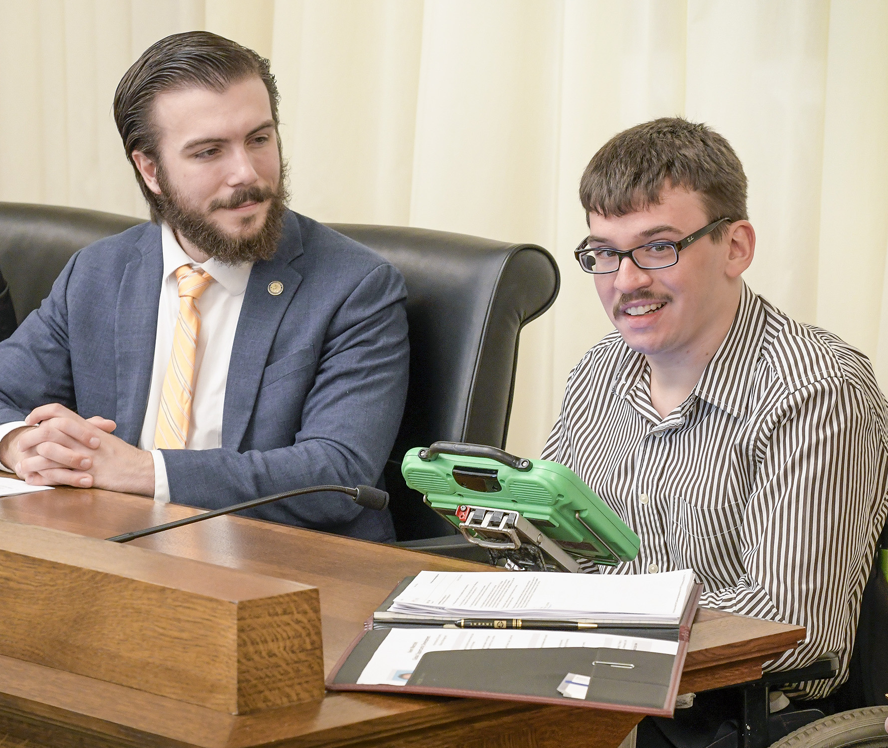
3.5
Identify Need for Advocacy in Relation to the PWD’s Participation

Slide 66
Like everybody else, PWDs also have the right to advocacy.
They have the right to exercise their choice and control.
As a support worker, you need to assist your clients in ensuring that they can practice their advocacy.
You do this by consulting with the PWD and identifying which part of their life is in need of advocacy.
Identify, Address and Monitor Barriers to Community Participation and Social Inclusion

Slide 67
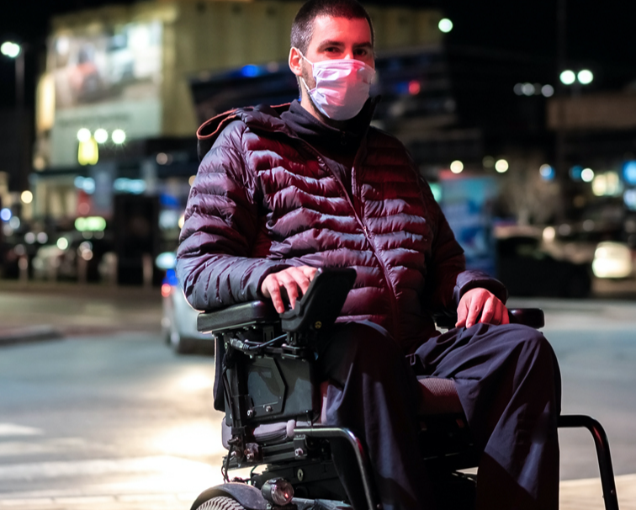
3.5.1 Identifying the PWD’s Needed Advocacy
Disability advocacy is important for the PWD to have a good life.
PWDs need advocacy for equality in treatment and in the accessibility of resources and opportunities.
Identify, Address and Monitor Barriers to Community Participation and Social Inclusion

Slide 68
They need to have equal access to many aspects of life, including, but not limited to, the following:
Safety
Employment
Education
Health
Income
Recreation
Identify, Address and Monitor Barriers to Community Participation and Social Inclusion

Slide 69
As such, you need to identify any areas clients wish to have an advocate for in order to improve the quality of their community participation.
These areas could be:
How they are treated in the community
How systems in the community work
Identify, Address and Monitor Barriers to Community Participation and Social Inclusion

Slide 70
In dealing with areas where advocacy is needed, you need to learn about two among the many types of advocacies:
Individual advocacy – It is a one-on-one approach to prevent or address instances of unfair treatment.
Systemic advocacy – It deals with changing legislation, policies or rules that impact a person’s life.
Identify, Address and Monitor Barriers to Community Participation and Social Inclusion

Slide 71

3.5.2 Strategies and Techniques for Individual Advocacy
Once you have determined the area where individual advocacy is required, consider the following strategies:
Informal Advocacy – It is where the client chooses an advocate to speak on their behalf from their support system.
Advocates can be:
Family members
Identify, Address and Monitor Barriers to Community Participation and Social Inclusion

Slide 72
Once you have determined the area where individual advocacy is required, consider the following strategies:
Informal Advocacy – It is where the client chooses an advocate to speak on their behalf from their support system.
Advocates can be:
Close friends
Primary caregivers
Identify, Address and Monitor Barriers to Community Participation and Social Inclusion

Slide 73
Once you have determined the area where individual advocacy is required, consider the following strategies:
Informal Advocacy – It is where the client chooses an advocate to speak on their behalf from their support system.
Advocates can be:
Partners or significant others
Relevant others, e.g. any person that the clients trust to speak on their behalf
Identify, Address and Monitor Barriers to Community Participation and Social Inclusion

Slide 74
Once you have determined the area where individual advocacy is required, consider the following strategies:
Formal Advocacy – It is where the client chooses an advocacy service to speak on their behalf. There are two types of agencies that are available through the NDAP:
Generalist agencies provide advocacy support to people with any type of disability or cultural background.
Identify, Address and Monitor Barriers to Community Participation and Social Inclusion

Slide 75
Once you have determined the area where individual advocacy is required, consider the following strategies:
Formal Advocacy – It is where the client chooses an advocacy service to speak on their behalf. There are two types of agencies that are available through the NDAP:
Specialist agencies may provide advocacy support to PWDs:
With a specific type of disability
With specific issues such as housing, education or employment
Identify, Address and Monitor Barriers to Community Participation and Social Inclusion

Slide 76
Once you have determined the area where individual advocacy is required, consider the following strategies:
Formal Advocacy – It is where the client chooses an advocacy service to speak on their behalf. There are two types of agencies that are available through the NDAP:
Specialist agencies may provide advocacy support to PWDs:
From diverse cultural and linguistic backgrounds, including Aboriginal and Torres Strait Islander backgrounds
Identify, Address and Monitor Barriers to Community Participation and Social Inclusion

Slide 77
Techniques of both informal and formal advocacies include the following:
Identifying and explaining the different options available to the client
Helping the client develop their skills and knowledge for expressing themselves
Assisting the client in standing up for their rights
Speaking with service providers on behalf of the client
Identify, Address and Monitor Barriers to Community Participation and Social Inclusion

Slide 78
Techniques of both informal and formal advocacies include the following:
Relaying wishes and preferences to other service providers and institutions
Assisting the client in transitioning from one service to another
Resolving concerns or submitting complaints to service providers or authorities
Identify, Address and Monitor Barriers to Community Participation and Social Inclusion

Slide 79
3.5.3 Strategies and Techniques for Systemic Advocacy
The aim of this advocacy is to enact change at a local, state or national level. Strategies for systemic advocacy include the following:
Policy monitoring – involves observing the implementation and effectiveness of policies already in place.
Advocacy campaigns – is an organised movement that aims to influence political change and bring awareness around issues to the public.
Identify, Address and Monitor Barriers to Community Participation and Social Inclusion

Slide 80

3.6
Monitor the Effectiveness of Strategies

Slide 81
You will learn how to monitor the success of the strategies implemented.
This will help you identify if there are issues that your client may not have mentioned.
Doing your own monitoring will also help you know if you need to make any changes.
If you do not monitor the success of your strategies, you might continue using ineffective ones.
Identify, Address and Monitor Barriers to Community Participation and Social Inclusion

Slide 82

Monitoring Success of Strategies
To monitor the success of your strategies, look at how your clients are during their activities with their communities and social networks.
Identify, Address and Monitor Barriers to Community Participation and Social Inclusion

Slide 83
You can check for effectiveness by asking the following questions:
Is my client enjoying socialising with their community or social network?
Is my client fully able to take part in their community or social network? Am I meeting all the needs of my client?
Has my client made any complaints or comments about the strategy so far? Have I addressed those complaints or comments?
Is the approach that I am using helping my client socialise with others?
What are the issues I have faced so far while using this strategy?
Identify, Address and Monitor Barriers to Community Participation and Social Inclusion

Slide 84
You will know that your strategies are meeting the needs of your clients if they do the following:
Criteria | Details
The client takes part in all aspects of the activity. | You ensure that they do not feel left out. You provide them with all the tools they need to participate.
The client finds the activity safe and enjoyable. | They are having fun. They are not experiencing discrimination.
Identify, Address and Monitor Barriers to Community Participation and Social Inclusion

Slide 85
You will know that your strategies are meeting the needs of your clients if they do the following:
Criteria | Details
You address the client’s feedback and complaints. | You provide solutions to the issues the client raises.
Identify, Address and Monitor Barriers to Community Participation and Social Inclusion

Slide 86

Consulting With the Client and Your Supervisor
Once you have gathered your observations on the implemented strategies, you must consult with the client and your supervisor.
Identify, Address and Monitor Barriers to Community Participation and Social Inclusion

Slide 87

3.7
Identify Own Limitations in Addressing Issues and Seek Advice From Supervisor

Slide 88
When working with PWDs, you should know what you are and are not qualified to do.
Understanding this will help you to recognise your limitations when addressing issues.
Once identified, you must seek the support of your supervisor.
Identify, Address and Monitor Barriers to Community Participation and Social Inclusion

Slide 89
3.7.1 Understanding Scope of Own Job Role or Ability
The scope of your job role is the limitation of your role based on your position and training.
You can find out your scope of practice by looking at your job position in your employee handbook.
Going beyond your scope of practice or ability can lead to negative consequences.
You may accidentally cause harm to your clients if you do something outside of your work role or training.
You must confirm your responsibilities and expectations with your supervisor.
Identify, Address and Monitor Barriers to Community Participation and Social Inclusion

Slide 90
Your supervisor is responsible for:
Communicating the organisational needs to you
Overseeing your performance as a disability support worker
Providing you support and guidance
Telling you the exact requirements of your job role once you are hired
Identify, Address and Monitor Barriers to Community Participation and Social Inclusion

Slide 91
When identifying limitations with your supervisor, you may ask them the following questions:
What tasks can I perform?
What tasks am I not allowed to perform?
What will my typical work day look like?
What are my main responsibilities?
Identify, Address and Monitor Barriers to Community Participation and Social Inclusion

Slide 92
When identifying limitations with your supervisor, you may ask them the following questions:
What are the other possible responsibilities that might get assigned to me?
If there is a task I am not allowed to perform, to whom do I refer my client?
Identify, Address and Monitor Barriers to Community Participation and Social Inclusion

Slide 93
3.7.2 Seeking Advice From Supervisor
You can refer to the following strategies when seeking advice from your supervisor:
Identify the part of your client’s care that falls outside your job role or ability.
Consider the best time to seek your supervisor’s advice.
State what you need clearly, briefly and honestly.
Communicate any new information regarding the client’s care.
Identify, Address and Monitor Barriers to Community Participation and Social Inclusion

Slide 94

What have we learnt?
In this part of the session, we have covered:
Identify opportunities for community participation and social inclusion
Implement strategies for community participation and inclusion
Identify, address and monitor barriers to community participation and social inclusion

Slide 95
End of Chapter 3

Slide 96

Presentation Objectives
Now that you have completed this presentation, you should be able to:
Identify opportunities for community participation and social inclusion
Implement strategies for community participation and inclusion
Identify, address and monitor barriers to community participation and social inclusion

Slide 97
End of CHCDIS012 Presentation

Slide 98
Version Control & Document History
Date | Summary of Modifications | Version
13 January 2023 | Version 1.0 released for publishing | 1.0
14 April 2023 | Version 1.1 endorsed for use Minor revisions for improved readability | 1.1

